Slide 1

Cycling: How to Beat Collision Statistics
Prepared for:
UofT Data Analytics
Project 1
Prepared by
Group 7:
Jason Demone
Ronald Lam
Tiara Mardosas
February 14, 2023
Notes:
Welcome to Project 1: TITLE

Slide 2

Land Acknowledgment
We acknowledge the land we are meeting on is the traditional territory of many nations including:
The Mississaugas of the Credit
The Anishnabek
The Chippewa
The Haudenosaunee
The Wendat peoples
It is now home to many diverse First Nations, Inuit and Métis peoples.
We also acknowledge that Toronto is covered by Treaty 13 with the Mississaugas of the Credit.
Notes:
How-den-oh-shau-nee

Slide 3
Agenda
Introduction
Assumptions & Questions
Analysis
Next Steps
References
Summary

Slide 4

Introduction

Slide 5
Introduction: Project Overview
Identify
Analyze
Apply
Identify the characteristics and conditions that may impact cycling safety
Analyze potential conditions and find any relationship within the data
Use findings to promote safer cycling conditions for all cyclists, both current and upcoming
Notes:
Here is just our project overview:
First we wanted to identify the characteristics and conditions that may impact cycling safety
Next we analyzed potential conditions to find if there are any relationships within the data
Lastly, through applications, we can use these findings to promote safer cycling conditions for all cyclists, both current and upcoming

Slide 6

The Data
CycleStreets API (v2):
Modern JSON interface
Advocacy Data: Collision Report & Collisions Data
Date Range: 1999 – 2021
28,000+ rows of data
Data from police reports
Notes:
For our data we used the CycleStreets API (v2):
It is a Modern JSON interface
We used the Advocacy Data consisting of the Collision Report & Collisions Data
The Date Range is 1999 – 2021
We obtained over 28,000+ rows of data
The Data is collected from police reports

Slide 7
Assumptions & Questions

Slide 8
Assumptions
Cyclists involved in fatal collisions occurred at a higher rate in males between the ages of 20-30 years.
1
2
Other parties involved in fatal collisions occurred at a higher rate in females between the ages of 40-50 years.
3
External characteristics, such as night-time and wet-roads, increased the risk of fatal cycling collisions.
Notes:
We had general assumptions about cycling collisions:
First...
Second...
Third...

Slide 9
Guiding Questions
What are the most common characteristics of cyclists involved in fatal collisions?
1
2
What are the characteristics of other parties involved in cycling fatal collisions?
3
Which external conditions are commonly associated with cycling fatal collisions?
Notes:
These assumptions then led us to our questions:
First...
Second...
Third...

Slide 10
Analysis

Slide 11
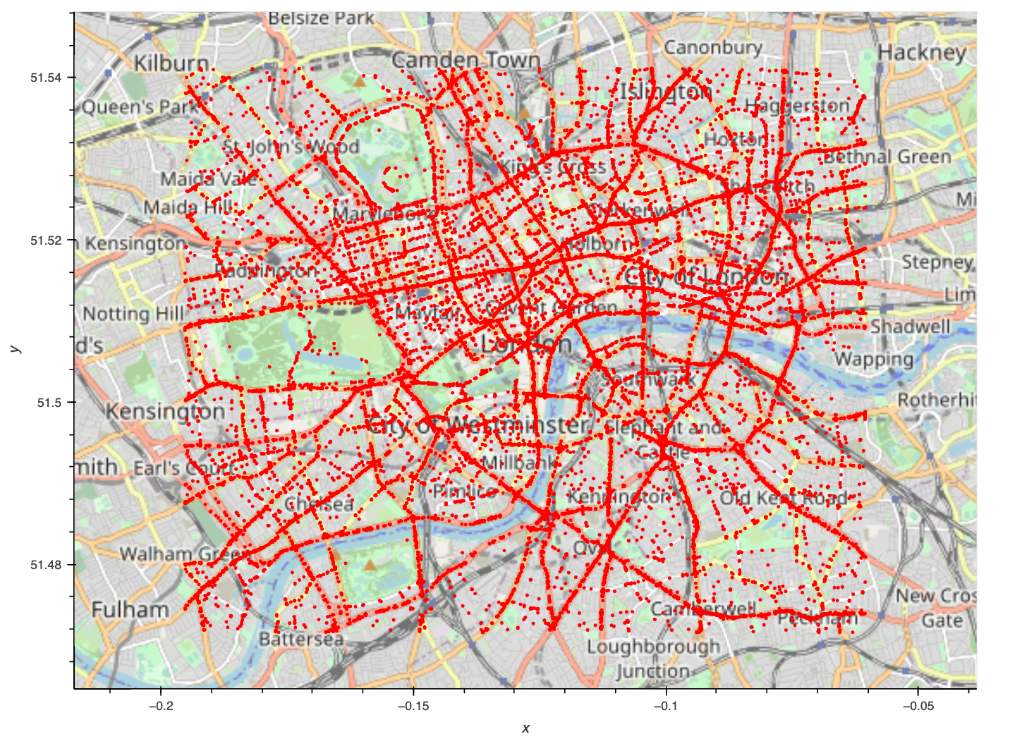
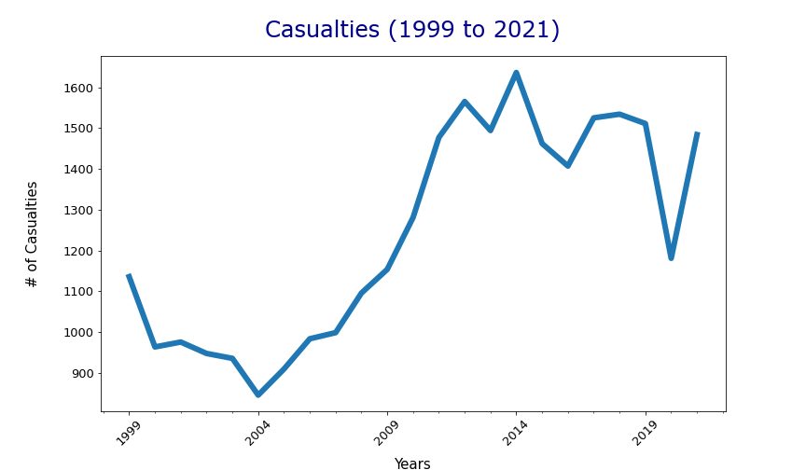
Geography
“Total Collisions in Central London”
Notes:
This slide consists of the Total Collisions in Central London. This is inclusive of slight, serious and fatal. We can see denser points at junctions.

Slide 12
Definition: “Severity”
Slight
Requiring minor roadside attention:
Neck pain
Shallow cuts/lacerations/abrasions
Sprains and strains
Bruising / Slight shock
Serious
Severe injuries requiring medical attention:
Broken bones
Internal injuries
Bruising / Slight shock
Deep cuts, wounds
Death more than 30 days after injury
Fatal
Subsequent death
Or death within 30 days of injury
No other related factors, such as virus
Notes:
There are three classifications of severity:
Slight is if the casualty feels neck pain and bruises
Serious is if they have broken bones or internal injuries
Fatal is death at time of collision or death within 30 days of injury. We focused on the fatal collisions.

Slide 13
Time
Notes:
This time series allows us to visualize all total causalities over each year.
We see an increase in 2004 with a peak in 2014, which is likely related to the increase in ridership due to the Transport for London (TfL); a cycle for hire system throughout the city centre.
Interestingly, we can even see the impact of COVID on cycling rates, see the decline in 2020 then the increase in 2021 as lives start to normalize

Slide 14
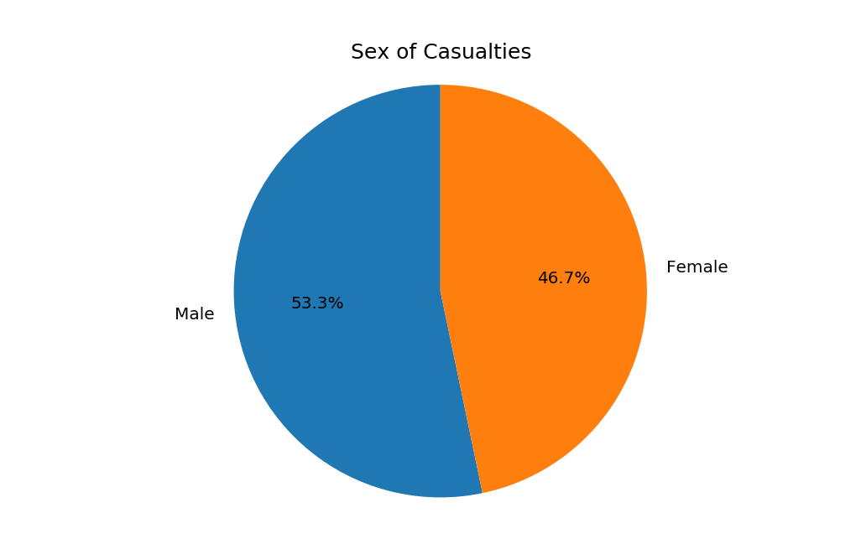
1
What are the most common characteristics of cyclists involved in fatal collisions?
Slightly more male than female fatal casualties
Notes:
Assumption
Casualties involved in collisions occurred at a higher rate in males between the ages of 20-30 years.
Our assumption was a "higher rate in males" would be involved in fatal cycling collisions. As we can see from this pie chart, this would be correct.

Slide 15
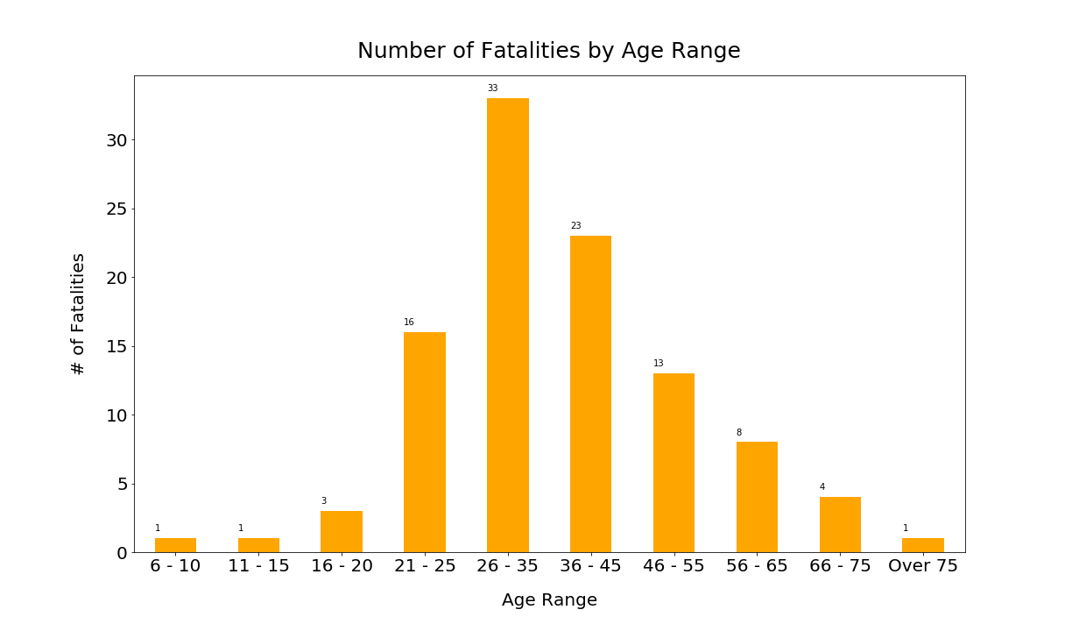
1
What are the most common characteristics of cyclists involved in fatal collisions?
Ages 26-35 years are most commonly involved in fatal collisions
Occurring among working class
Notes:
Assumption
Casualties involved in collisions occurred at a higher rate in males between the ages of 20-30 years.
As we can see from this bar chart, contrary to our assumption of 20-30 years, the majority of casualties involved with fatal cyclist collisions are between the ages 26-35 years.
We might make the assumption that people between 21 through 55 are probably working. Therefore, the cyclists involved in collisions likely happens among working class (commuters).

Slide 16
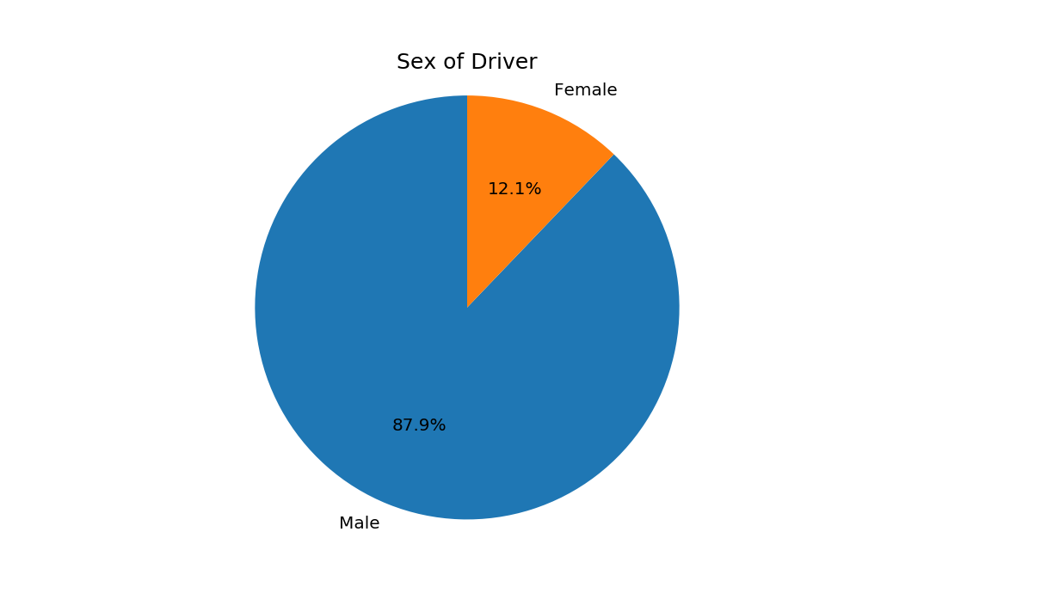
2
What are the characteristics of other parties involved in fatal cycling collisions?
Drivers are 87.9% male
Notes:
Assumption
Other parties involved in collisions occurred at a higher rate in females between the ages of 40-50 years.
Our assumption was a "higher rate in females" would be involved in cycling collision. As we can see from this pie graph plotting sex of drivers, contrary to our assumption, the majority of drivers involved with cyclist collisions are male at 87.9%.

Slide 17
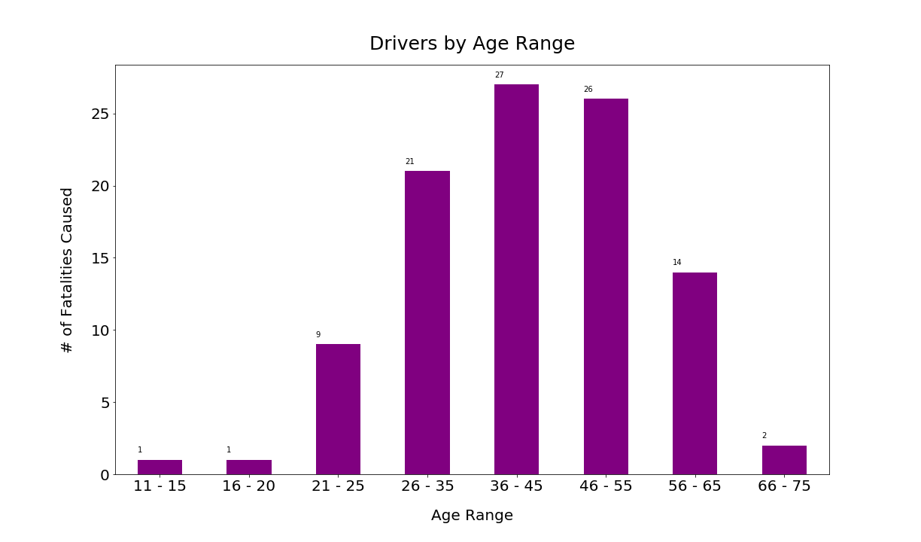
2
What are the characteristics/factors of other parties involved in fatal cycling collisions?
Ages 36-55 years are most involved in fatal collisions
The great majority of collisions involve working age individuals
Notes:
Assumption
Other parties involved in collisions occurred at a higher rate in females between the ages of 40-50 years.
BOXPLOT
Our assumption " females between the ages of 40-50 years" would be involved most in cycling collision. Parties between the ages 36-55 are more likely to be involved with cyclist collisions.

Slide 18
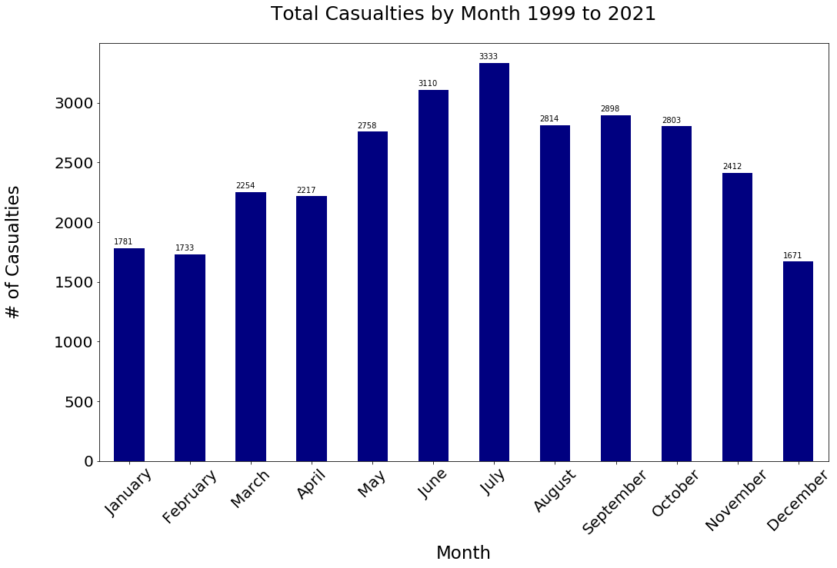
3
Which external conditions are commonly associated with fatal cycling collisions?
More casualties:
May to October
Peak during summer months
Notes:
Assumption
External characteristics, such as night-time and wet-roads, increased the risk of cycling collisions.
All avg line
Cycling is an outdoor activity and our data analysis also demonstrates the seasonal relationship of cyclist collisions. Conversely, during the winter months of December to February have a lower total collisions comparatively to the warmer seasons.

Slide 19
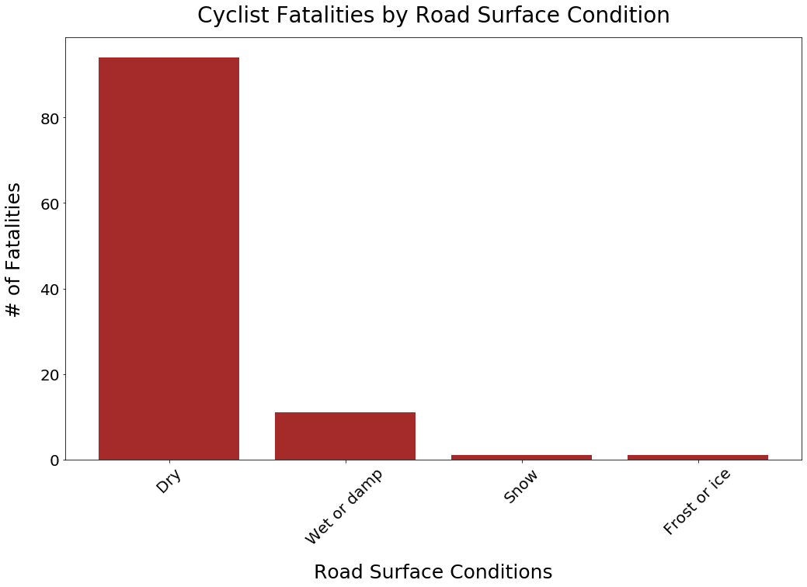
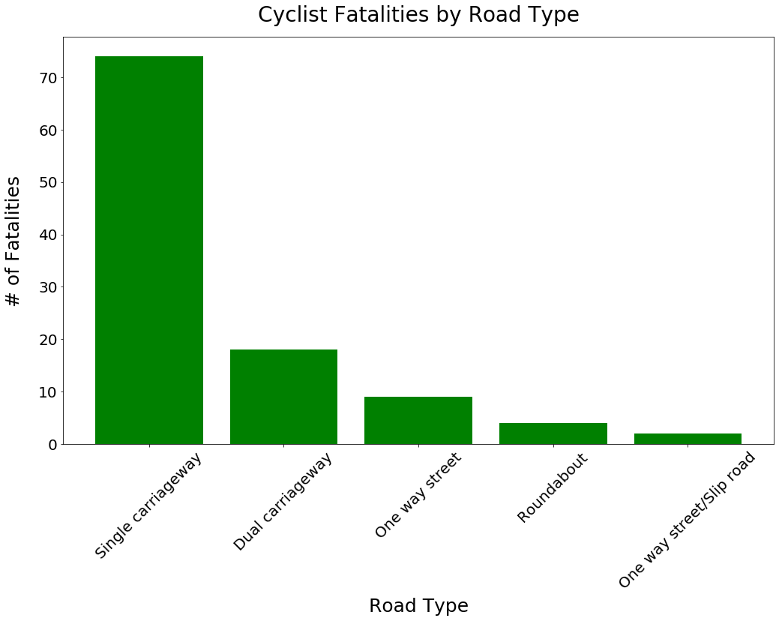
3
Which external conditions are commonly associated with fatal cycling collisions?
87.9% on dry surface
69.2% on “single carriageway”
Notes:
Assumption
External characteristics, such as night-time and wet-roads, increased the risk of cycling collisions.
Single Carriageway means that there is no barrier dividing the street.
This does not include a line.

Slide 20
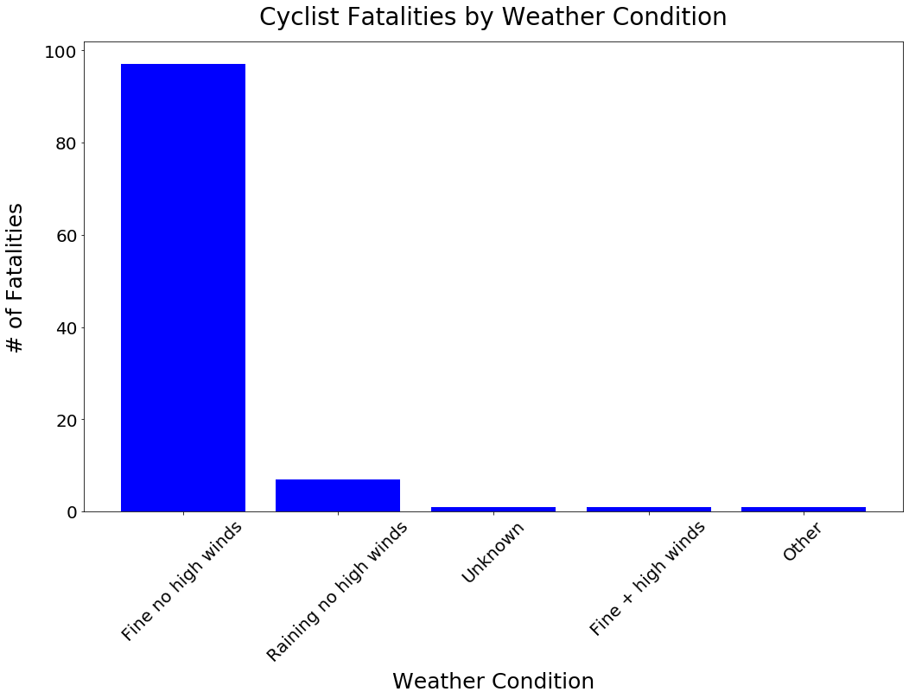
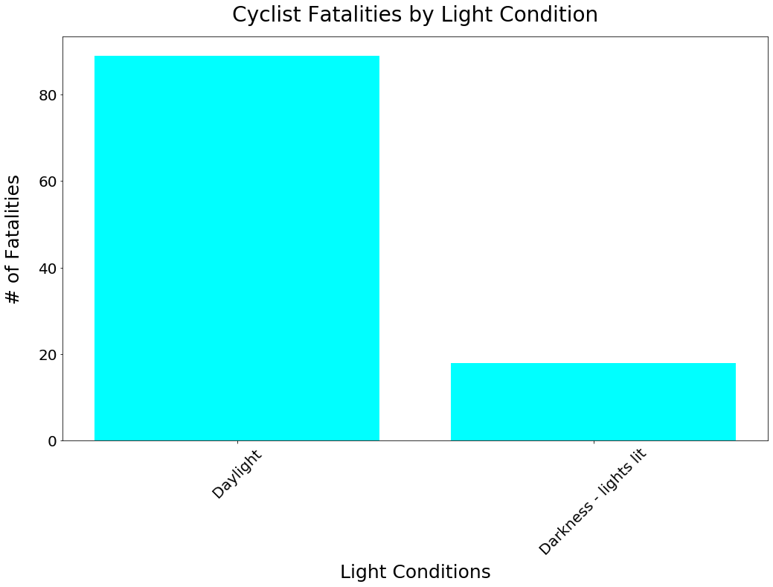
3
Which external conditions are commonly associated with fatal cycling collisions?
90.7% during pleasant weather
83.2% during daylight
Notes:
Assumption
External characteristics, such as night-time and wet-roads, increased the risk of cycling collisions.

Slide 21
Summary

Slide 22
Summary
Male cyclists are at a slightly increased risk. Cyclists aged 26-35 years are at an increased risk for fatal collisions.
The majority of drivers involved in fatal cycling collisions are male. Drivers between the ages of 36-55 years are more likely involved with fatal cyclist collisions.
Question 1
What are characteristics of cyclists in fatal cycling collisions?
Most fatalities take place on a dry surface, in a single carriageway, with clear weather and ample daylight.
Question 3
What are external characteristics that influence fatal cycling collisions?
Question 2
What are characteristics of other parties involved in fatal cycling collisions?
Notes:
Thank you, Ronald. Based on these findings, we have learned:
… that males, are at a slightly higher likelihood of being involved in a collision, when compared to females. The age range for cyclists most likely involved is between the ages of 26 and 35, higher than we assumed.
For our second question about drivers.
Our assumption was incorrect, the majority of drivers involved in these collisions are mostly male, at 87.9%
Our assumption about the age range was partially correct. Drivers between the ages of 36-55 are more likely to be involved with cyclist collisions.
And finally, when looking at external conditions, most collisions take place on a dry surface, in a single carriageway, with clear weather and ample daylight.

Slide 23
Key Insights
What have we learned from the data?
What does this tell us about the cyclists?
Working class
Most accidents during sunny, dry conditions
What does this tell us about the drivers?
36-55 years old, not as aware
Females more cautious drivers
Notes:
So, what have we learned from this data?
First, let’s consider the cyclists. Cyclists are commuters, who are part of the working class. Most accidents tend to occur when people are cycling on a nice, sunny, dry day.
What does this tell us about the drivers? Drivers aged 36-55 years old are not as aware. Also, ,based on the data, we can infer that female drivers are more cautious than their male counterparts.

Slide 24
Limitations
What limitations could be found within this data set?
Selecting boundaries of Central London
Inconsistent data reporting, bias and human error
Notes:
Limitations. As with all data sets, there are some limitations within this data that may have may impacted the interpretation of these results.
As you are aware, these reports are from Central London. We recognize that this data may reflect some variations in lifestyle, most specifically weather conditions. It additionally only reflects cycling patterns in a major city.
Further, the data collected in this pool is also built solely from police reports. This means there are most likely many unreported cases, which could skew our data. For example, women or individuals in a different age bracket may be less likely to report.

Slide 25
Next Steps

Slide 26
Next Steps : Application
How can we apply what we have learned from the data?
How can we make drivers and cyclists more aware?
Cyclists:
Infrastructure
Encourage safer routes
Drivers:
Signs to increase awareness of cyclists
Educate
Notes:
So, how can we apply this knowledge to make drivers and cyclists more aware?
For cyclists – Safety can be supported by providing new infrastructure such as cycling lanes with dividers. In addition, emphasis can be put on educating cyclists about safer routes, such as ones with less automotive traffic and designated cycling lanes.
Drivers can be supported, as well, through education. These initiatives could include new signage to promote awareness for safer practices, such as speed limit feedback signs or hazard signs, such as slowing down in the presence of cyclists.
Further awareness could also be promoted through public education, such as public service announcements targeted towards males between the ages of 36 to 55.
(Pause)
With this knowledge intact, promoting awareness and safe practices will hopefully create a safer cycling environment and help decrease the number of collisions involving cyclists. Thank you.

Slide 27
Acknowledgements
CycleStreets API
UofT Data Analytics
Madhur
Ken
Josh
Notes:
Before we concludes we would would like to thank: Cycle Streets Api, UofT Data Analytics for this opportunity and our fabulous leaders, Madhur, Ken and Josh for their ongoing support and wisdom.

Slide 28
References
(2020, August 29). Bicycles Accident Analysis. Medium. Retrieved February 7, 2023, from https://medium.com/analytics-vidhya/bicycles-accident-analysis-a5d178a1b6f2
(2023). [Cycle Streets Logo] [Photograph]. Cycle Streets. www.cyclestreets.net
Cycle Streets (2020, August 29). Cycle Streets API. Retrieved February 7, 2023, from https://www.cyclestreets.net/api/
Department for Transport (UK Government) (2011, September 1). Cities in United Kingdom. Instructions for the Completion of Road Accident Reports From Non-CRASH Sources. Retrieved February 6, 2023, from https://assets.publishing.service.gov.uk/government/uploads/system/uploads/attachment_data/file/ 995423/stats20-2011.pdf
LatLong.net (2012-2023.). Cities in United Kingdom. Retrieved February 6, 2023, from https://www.latlong.net/category/cities-235-15.htmlImages
National Association Of City Transportation Officials (n.d.). CYCLING NEAR MISSES: Findings from Year One of the Near Miss Project. NACTO. Retrieved February 9, 2023, from https://nacto.org/wp-content/uploads/2017/11/Nearmissreport-final-web-2.pdf
Notes:
These are our references.

Slide 29



Thank you
Cycle Safely
Jason Demone
Ronald Lam
Tiara Mardosas
Cycle Toronto. - https://www.cycleto.ca
Bikes Without Borders - https://bikeswithoutborders.org
Notes:
Thank you again for listening to our presentation.
Cycle safely!

